Slide 1


To do management system
Institute for Advanced Computing and Software Development (PG-DAC)
By :-
ABHINAV SHRIVASTAVA- 210941220005
(Group No.94)
Guide: Mrs. Manjiri Deshpande

Slide 2
Objective
Define to do management.
Recording information about the day.
Recording information related to completion of work.
Updating to do list.

Slide 3
Scope of the Project
What work to do.
Proper date and time of work.
Proper scheduling and updation .

Slide 4
Modules:
Admin module

Slide 5
Admin module
Manage to do list.
Updating to do list on a regular basis .

Slide 6
UML Diagrams

Slide 7
id
password
admin
1
register
ER DIAGRAM
M
To do list
ID
Description
Date/Time

Slide 8
Login
Add to do
UUSE CASE DIAGRAM
View to do list
Actor Admin
Update to do list
delete to do list
Logout

Slide 9
Request
To do list
ADMIN
Response
Data Flow Diagram Level 0

Slide 10
Login
Add to do
Admin
Admin
View to do list
Update to do list
delete to do list
Logout
Data Flow Diagram Level 1

Slide 11
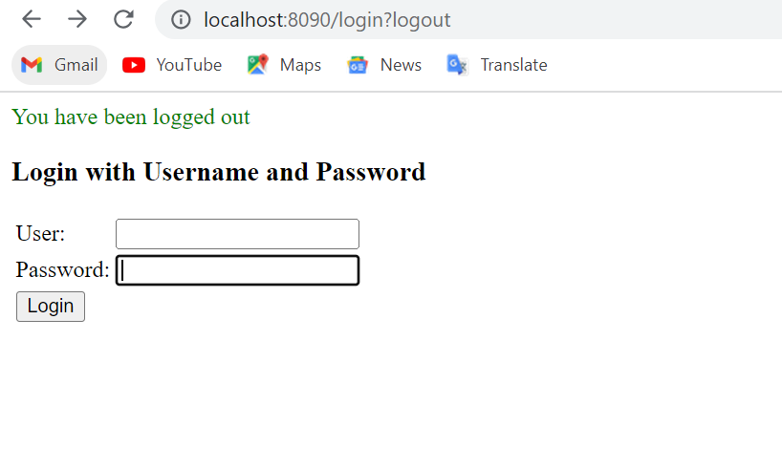

Slide 12
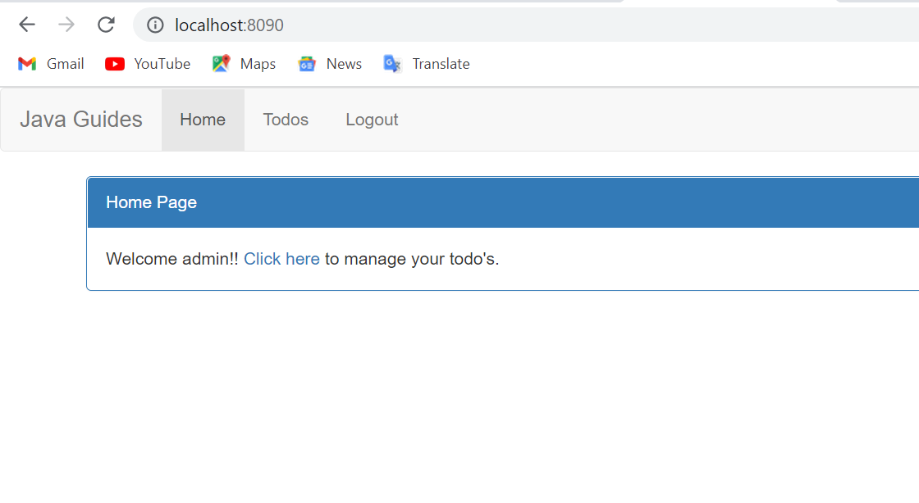

Slide 13
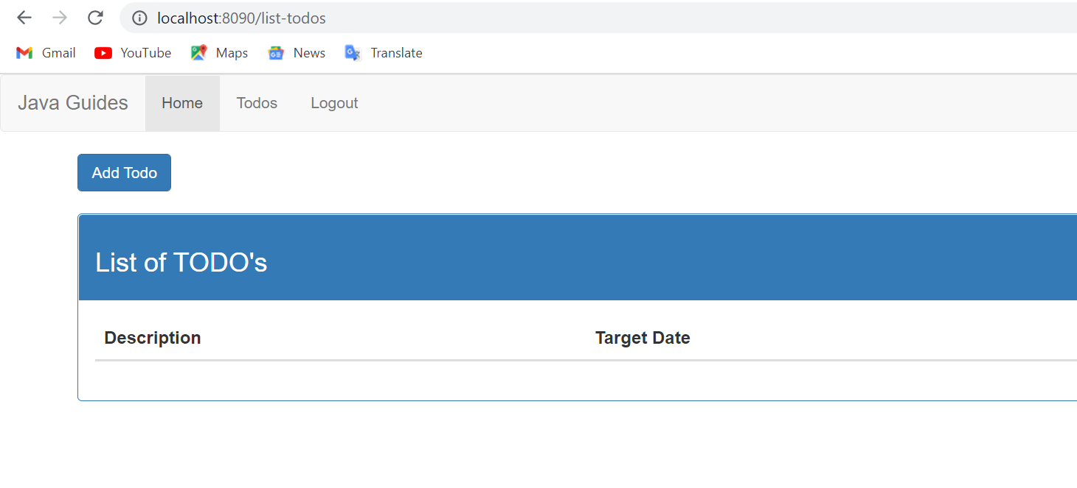

Slide 14
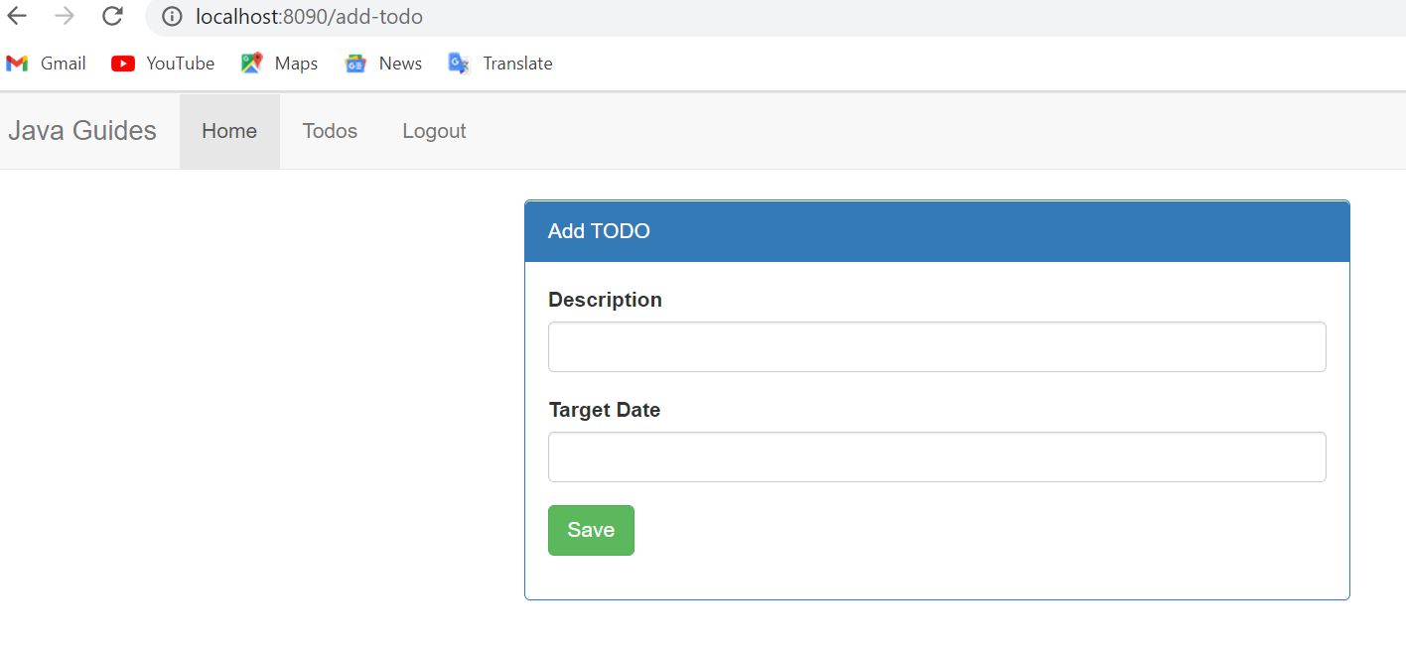

Slide 15
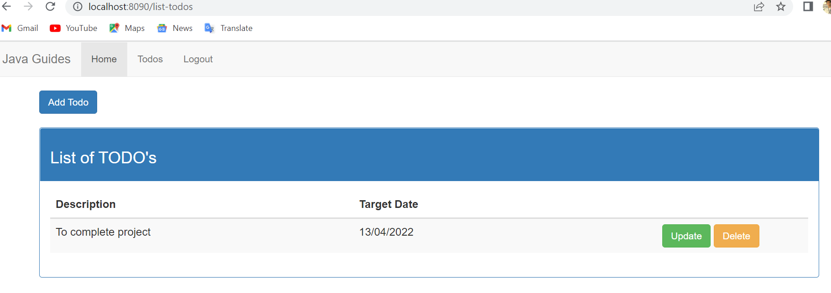

Slide 16
Thank You...

